Slide 1



`
Network Request
Xml/Json Parser
Created By: DoanPT1

Slide 2
Content
Communication between devices
HTTP and HTTPS
Http Request and Http Response
HttpURLConnection
Required Permissions and check the network availability
XML format and XmlPullParser
Json format and Json Parser
Gson
Retrofit
Retrofit with OkHttp
Retrofit with coroutines
Retrofit with RxJava3
Add Headers to requests
Logging with Retrofit

Slide 3
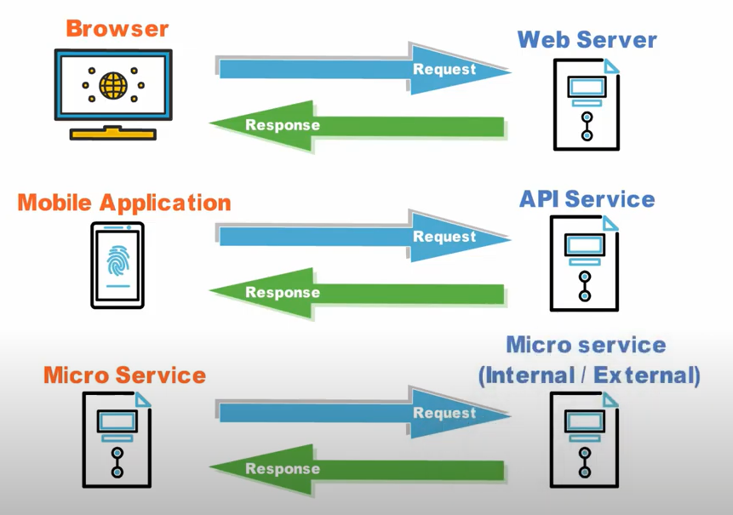
Communication
HTTP
HTTPS

Slide 4
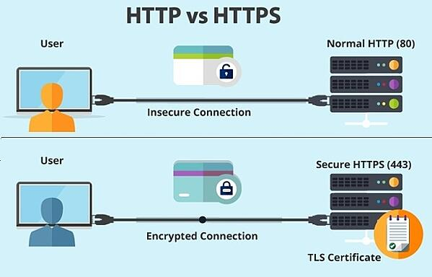
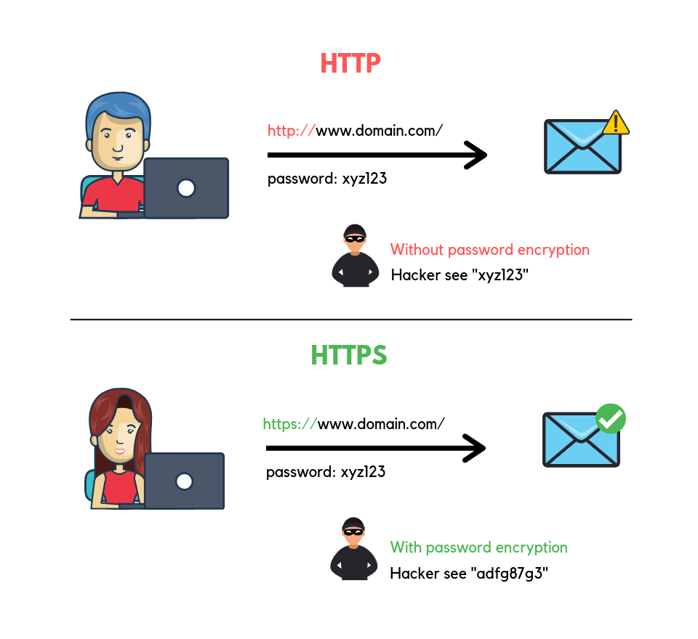
What is HTTP and HTTPS
HTTP is stand for Hyper Text Transfer Protocol. Communication between client computers and web servers is done by sending HTTP Requests and receiving HTTP Responses
HTTPS(Hypertext Transfer Protocol Secure) is the secure version of HTTP, which is the primary protocol used to send data between a web browser and a website. HTTPS is encrypted in order to increase security of data transfer
Notes:
https://www.youtube.com/watch?v=l1CnULyZLro&list=PLw-L1SGSvTEcBzw9FsP5UFWqrErzS2jE2&index=4
https://www.youtube.com/watch?v=Zxy_UYIQk1c&list=PLw-L1SGSvTEcBzw9FsP5UFWqrErzS2jE2&index=5
https://www.youtube.com/watch?v=l1CnULyZLro&list=PLw-L1SGSvTEcBzw9FsP5UFWqrErzS2jE2&index=6

Slide 5
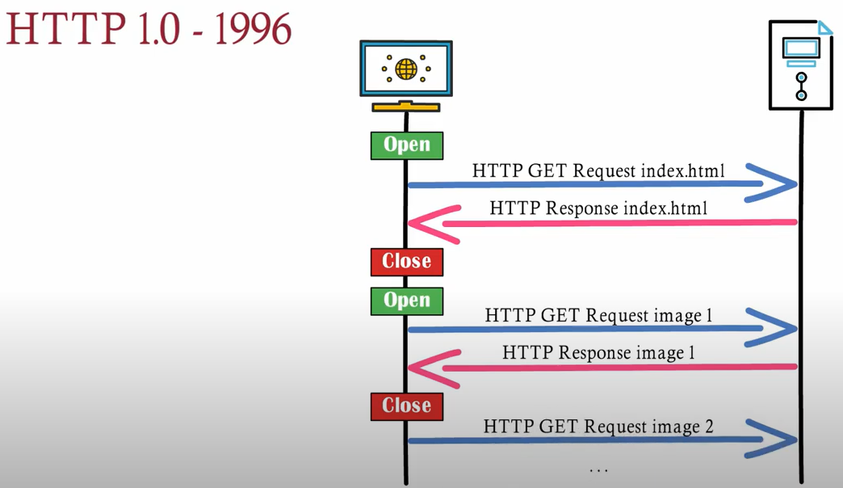
HTTP 1.0
With Http 1.0, for each request/response client must create a connection and close it after done the request

Slide 6
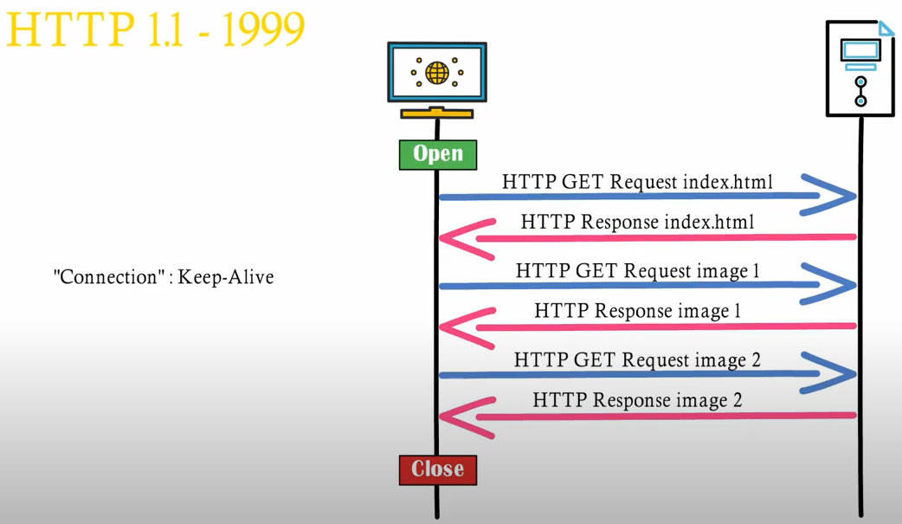
HTTP 1.1
With Http 1.1, the connection speed is faster because with one connection, server and client can do many request/response via “Connection:Keep-Alive” in header

Slide 7
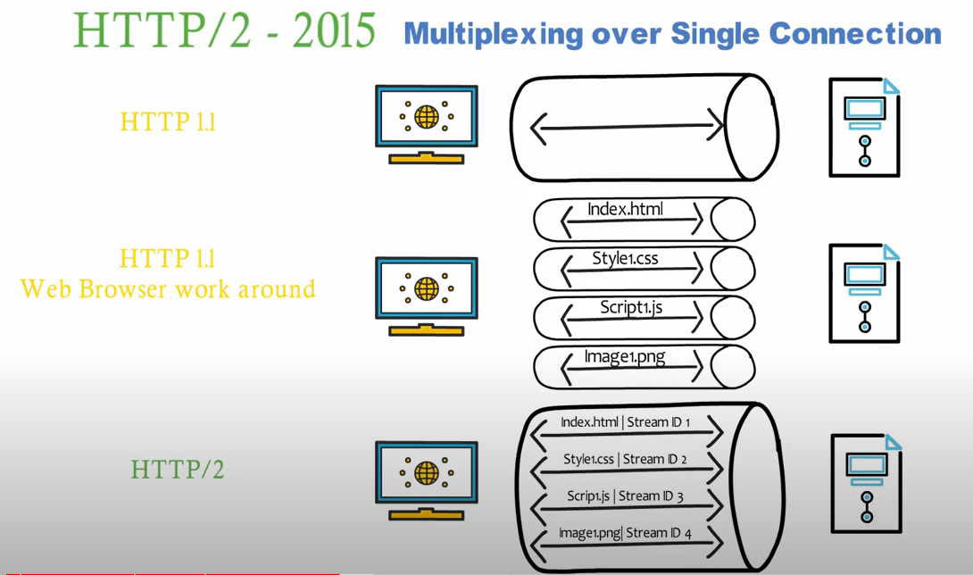
HTTP2
Index.html
Style.css
Script.js
Image1.png
Notes:
HTTP 1.1 sẽ thực hiện tranfser từng file 1, thông qua 1 connection, điều này khiến client mất rất nhiều time để lấy hết được các file về và hiển thị.
Browser có thể work around bằng cách tạo nhiều connection và transfer mỗi file trên 1 connection để tăng tốc độ, tuy nhiên việc tạo ra và duy trì nhiều connection sẽ làm tốn tài nguyên của cả client lẫn server
HTTP2 sinh ra cơ chế multiplexing over single connection, http2 tạo ra 1 khái niệm stream id giúp transfer multi file with one connection, tăng tốc độ load data giữa client và server

Slide 8
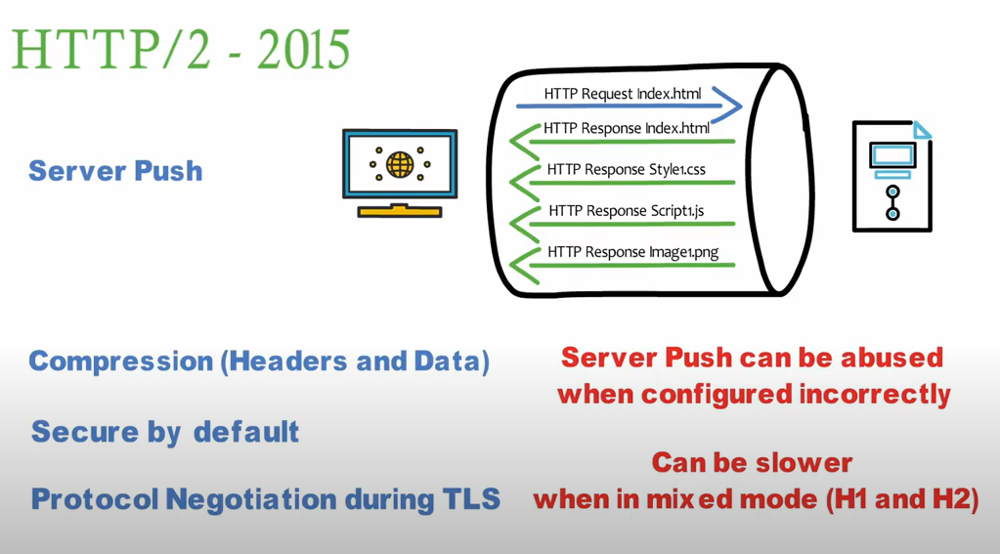
HTTP2
Compare speed between HTTP1 and HTTP2: https://http2.golang.org/gophertiles
Notes:
Ưu
Server push: Khi client request file index.html, server sẽ trả về file đồng thời check nội dung file index.html cần dùng file style1.css, script1.js, image1.png thì server sẽ tự động push 3 file đó về cho server luôn mà k cần chờ client request
Compression(Headers and Data): Header và Data của request sẽ được nén nhỏ lại trước khi gửi đi
Secure by default: Http2 không chạy trên cổng 80 mà mặc định chạy trên 443 vs mã hóa TLS
Protocol Negotiation during TLS: tự động check và chuyển thành http2 trong quá trình bắt tay nếu cả 2 cùng hỗ trợ http2
Lưu ý: Server push có thể hoạt động k chính xác nếu config sai
Có thể bị chậm hơn nếu mix Http1 và Http2

Slide 9
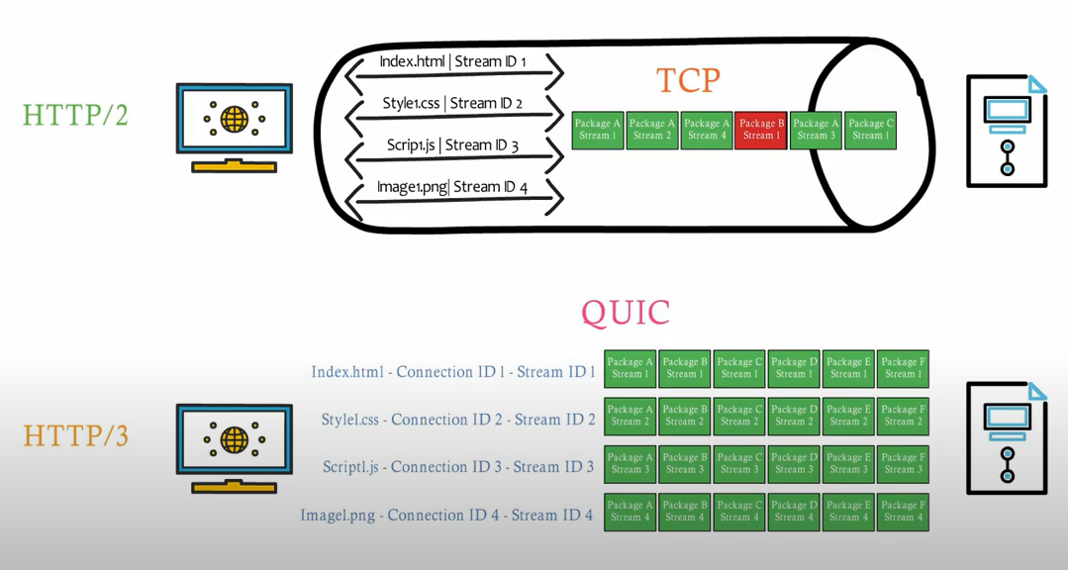
HTTP3 – Cải tiến việc truyền dữ liệu
Notes:
HTTP2 truyền các stream packages của tất cả các streams bằng giao thức TCP trên 1 connections, nếu có 1 package bị lỗi thì tất cả các gói tin còn lại(kể cả packages k lỗi) sẽ phải chờ hệ thống gửi lại packages đó.
Điểm yếu đó là vấn đề của giao thức TCP, nên để cải thiện vấn đề đó, các kỹ sư google đã cải tiến giao tức UDP kết hợp vs connection id, cơ chế truyền dẫn tin cậy và xử lý lỗi trên đường truyền để tạo ra giao thức QUIC.
Các stream truyền dẫn dữ liệu hoàn toàn độc lập vs các stream còn lại, nếu 1 stream bị lỗi thì các stream khác vẫn hoạt động bình thường.
Tham khảo TCP: https://www.youtube.com/watch?v=DC5SLPzwiro&list=PLw-L1SGSvTEcBzw9FsP5UFWqrErzS2jE2&index=3
Tham khảo UDP: https://www.youtube.com/watch?v=Ns8g02cHNk8&list=PLw-L1SGSvTEcBzw9FsP5UFWqrErzS2jE2&index=4

Slide 10
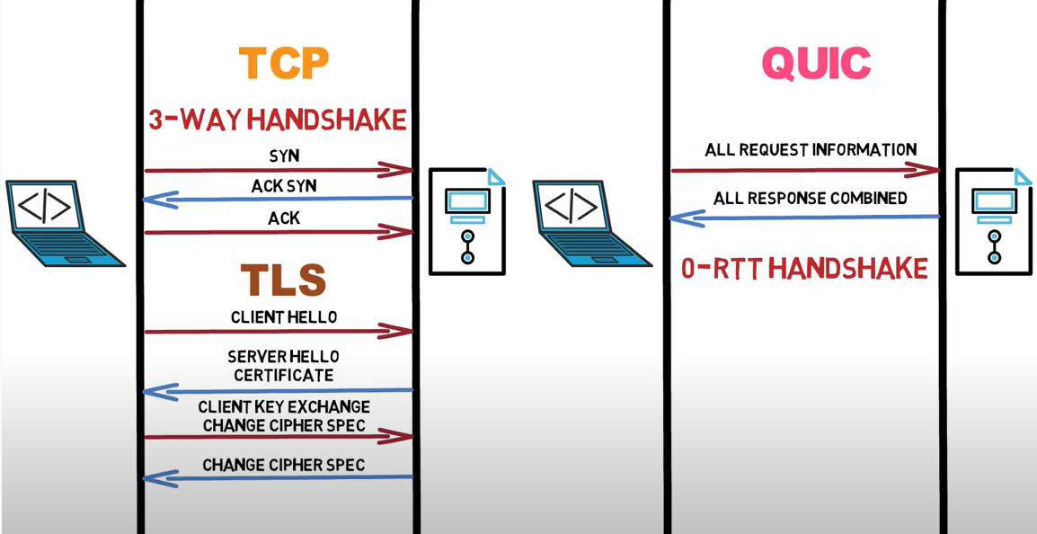
HTTP3 – Tăng tốc quá trình bắt tay
Notes:
Với HTTP2 dùng TCP thì để giao tiếp thì sẽ phải dùng cơ chế bắt tay 3 bước và thêm 1 số bước để xác thực và định danh. Tuy nhiên với HTTP3 sử dụng QUIC thì tất cả các việc này chỉ diễn ra trong 1 bước duy nhất, tất cả thông tin về truy vấn và xác thực cần thiết sẽ được truyền đi trong 1 request duy nhất, và kết quả sẽ được trả về trong 1 bước duy nhất, việc này cải thiện đáng kể tốc độ so vs TCP
Quá trình này trong QUIC được gọi là 0-RTT Handshake.
Hiện nay các ứng dụng của google đã chuyển sang HTTP3 ví dụ Youtube, Driver, Google.com...vv

Slide 11
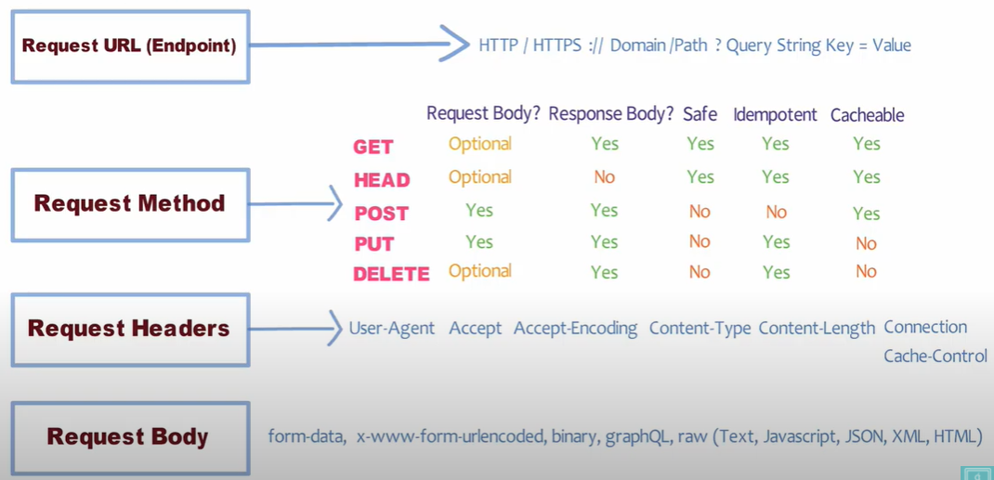
HTTP Request

Slide 12
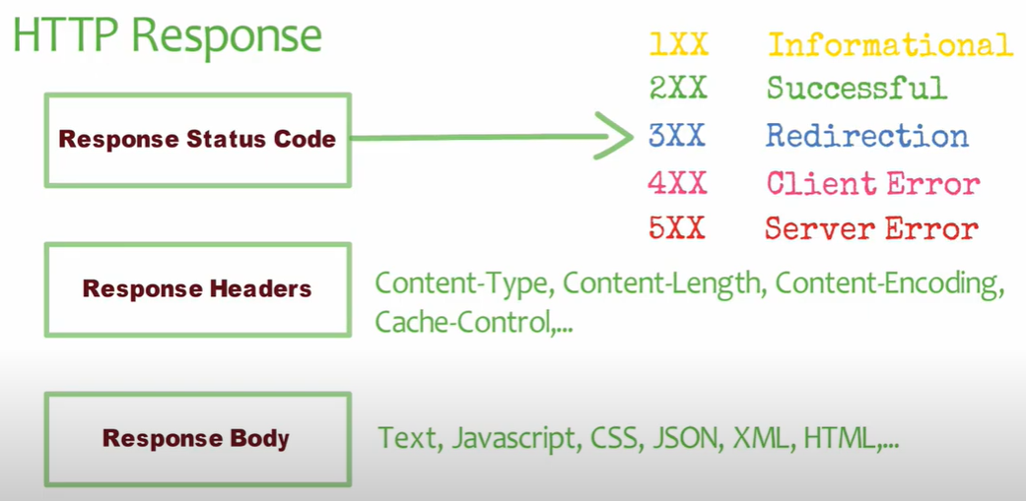
HTTP Response

Slide 13
HttpUrlConnection
HttpURLConnection is the standard HTTP client for Android, used to send and receive data over the web. It is a concrete implementation of URLConnection for HTTP (RFC 2616).
Using HttpURLConnection
Create URL object and pass a link as a parameter
Obtain a new HttpURLConnection by calling url.openConnection() and casting the result to HttpURLConnection
Prepare the request. The primary property of a request is its URI. Request headers may also include metadata such as credentials, preferred content types, and session cookies.
Optionally upload a request body. Instances must be configured with setDoOutput(true) if they include a request body. Transmit data by writing to the stream returned by URLConnection.getOutputStream().
Read the response. Response headers typically include metadata such as the response body's content type and length, modified dates and session cookies. The response body may be read from the stream returned by URLConnection.getInputStream(). If the response has no body, that method returns an empty stream.
Disconnect. Once the response body has been read, the HttpURLConnection should be closed by calling disconnect(). Disconnecting releases the resources held by a connection so they may be closed or reused.

Slide 14
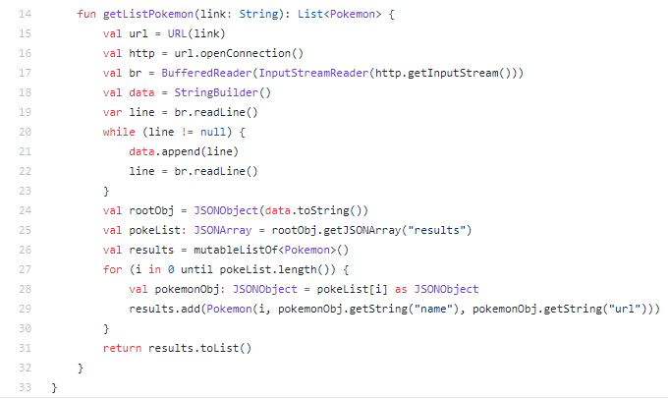
HttpURLConnection Example

Slide 15
Require Permission
To access the Internet your application requires the android.permission.INTERNET permission.
To check the network state your application requires the android.permission.ACCESS_NETWORK_STATE permission.
Network operations can involve unpredictable delays. To prevent this from causing a poor user experience, always perform network operations on a separate thread from the UI. Using Thread/AsyncTask/Coroutines/RxJava… to create worker thread for http request

Slide 16
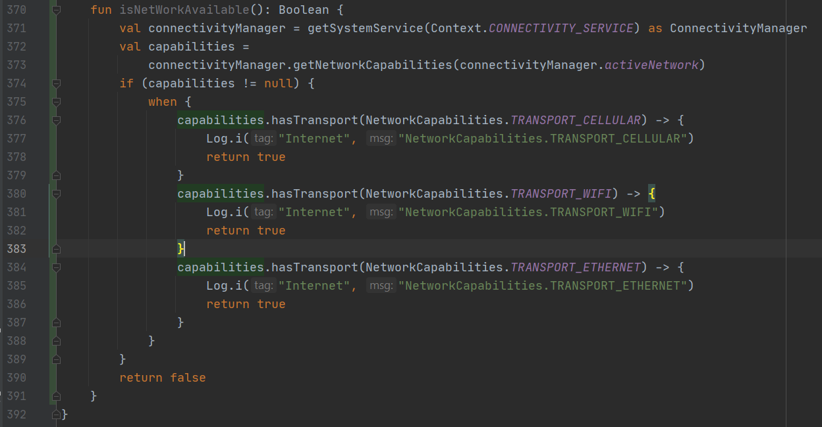
Check the network availability
Obviously the network on an Android device is not always available. You can check the network is currently available via the following code.

Slide 17
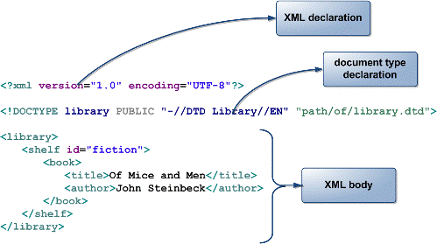
What is XML?
XML stands for Extensible Markup Language.XML is a very popular format and commonly used for sharing data on the internet
Websites that frequently update their content, such as news sites or blogs, often provide an XML feed so that external programs can keep abreast of content changes
Notes:
XML là viết tắt của Extensible Markup Language.
XML là một định dạng rất phổ biến và thường được sử dụng để chia sẻ dữ liệu trên internet
Các trang web thường xuyên cập nhật nội dung của họ, chẳng hạn như trang web tin tức hoặc blog, thường cung cấp nguồn cấp dữ liệu XML để các chương trình bên ngoài có thể theo kịp các thay đổi nội dung

Slide 18
Android XML Parser
Android Provide three types of XML Parser
XmlPullParser
DOM
SAX
Android recommend using XmlPullParser because It’s efficient, easy to use and maintainable
Refer: Comparing methods of XML parsing in Android
In Android, JSOUP is popular library for html parsing using DOM

Slide 19
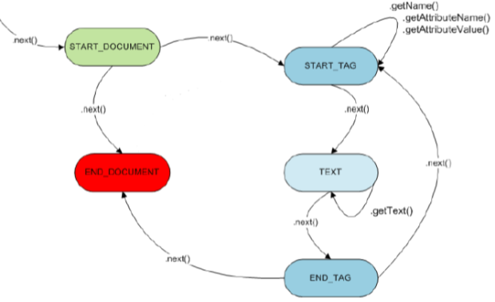
XML Pull Parser Flow

Slide 20
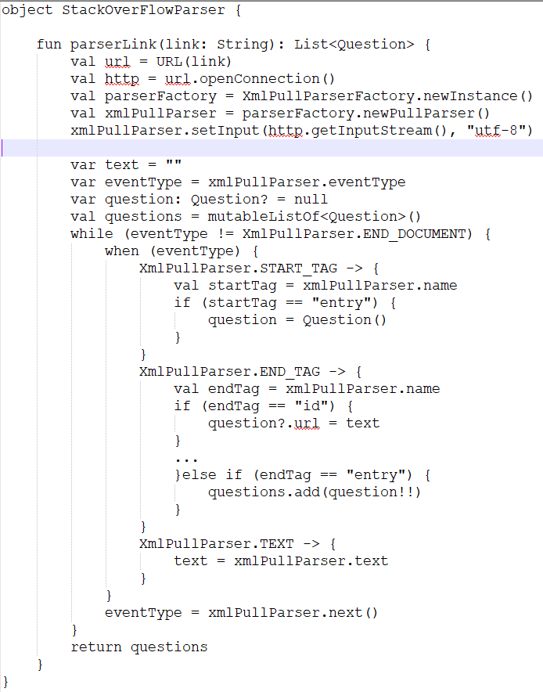
XML Pull Parser Example

Slide 21
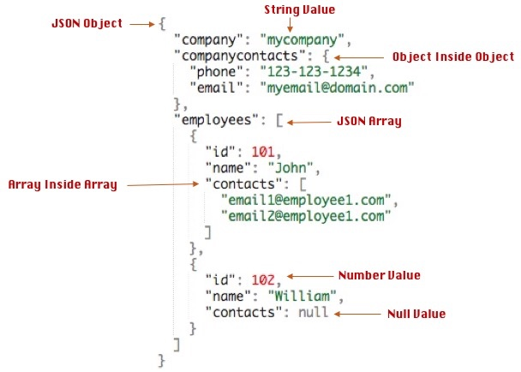
What is JSON
JSON stands for JavaScript Object Notation
JSON is very light weight, structured, easy to parse and much human readable.
JSON is best alternative to XML when your android app needs to interchange data with your server

Slide 22
Json Parser
Android provide include Json parser in native sdk.
There are 2 Object are: JSONObject and JSONArray
JSONObject: we can get attribute of object by getXXX(XXX is value type)
JSONArray: we can use as an Array and get element by index

Slide 23
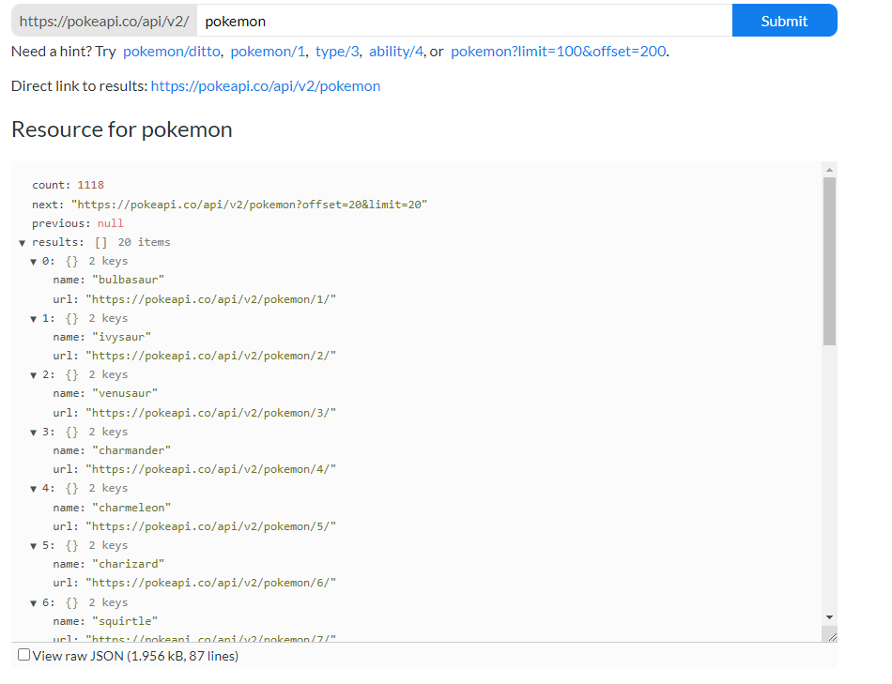

Slide 24
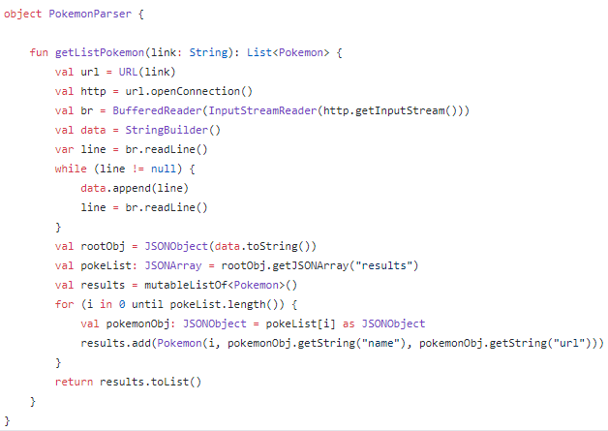
JSON Parser Example

Slide 25
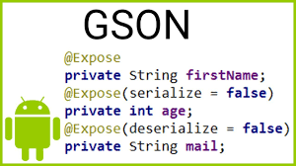
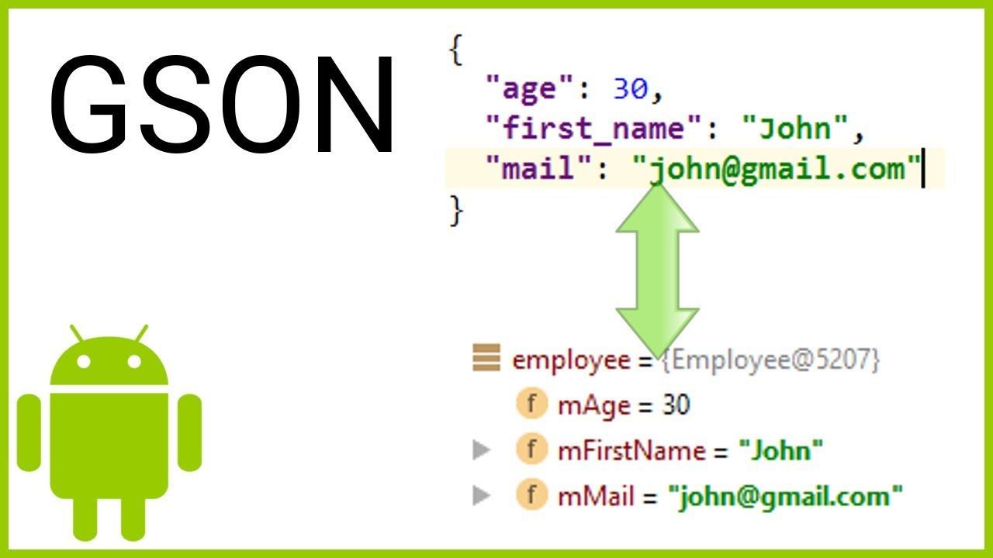
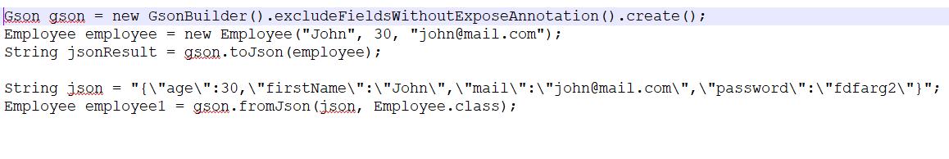
GSON
Gson is a Java library that can be used to convert Java Objects into their JSON representation. It can also be used to convert a JSON string to an equivalent Java object. Gson can work with arbitrary Java objects including pre-existing objects that you do not have source-code of

Slide 26
Retrofit
Retrofit turns your Rest API into a Interface
Simplifies HTTP communication by turning remote APIs into declarative, type-safe interfaces
A type-safe HTTP client for Android and Java
Created by Square(Jake Wharton)
Refer: Homepage and git repo

Slide 27
Retrofit work flow
Create an interface and define APIs
Create Retrofit instance using Retrofit.Builder
Let Retrofit class generates an implementation of Interface
Make a Synchronous or Asynchronous HTTP request

Slide 28
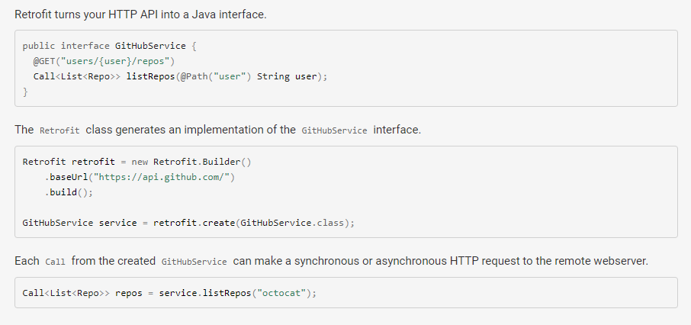
Retrofit work flow

Slide 29
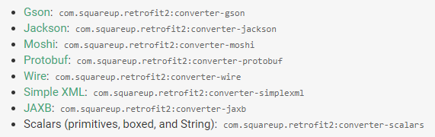
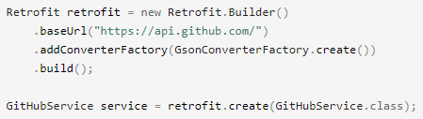
Retrofit converter
Retrofit is the class through which your API interfaces are turned into callable objects. By default, Retrofit will give you sane defaults for your platform but it allows for customization.
By default, Retrofit can only deserialize HTTP bodies into OkHttp's ResponseBody type and it can only accept its RequestBody type for @Body.
Converters can be added to support other types. Six sibling modules adapt popular serialization libraries for your convenience

Slide 30
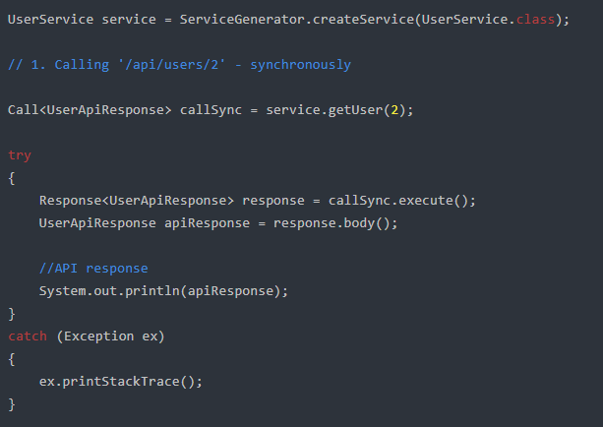
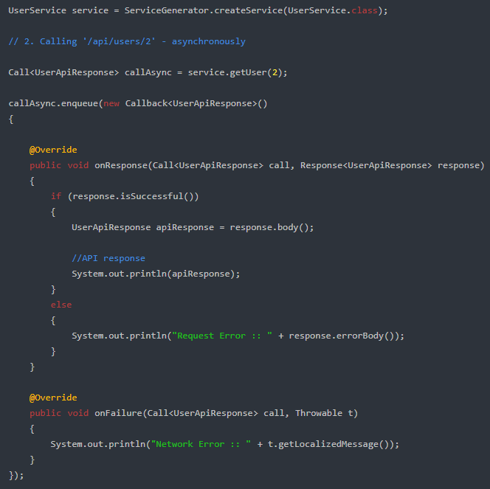
Retrofit Call
After have class generates implementation of Retrofit, you can make synchronous request by calling execute method, and asynchronous request by calling enqueue method

Slide 31
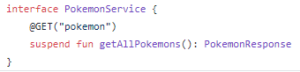
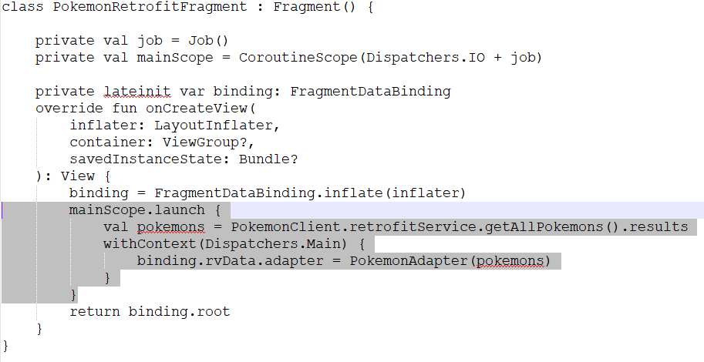
Retrofit with coroutines
We can add suspend keyword to api declaration then make retrofit api call in coroutines scope easily

Slide 32
Retrofit with RxJava
Retrofit also support RxJava call adapter by add a bit to the retrofit config
Add rxjava-retrofit-adapter to build.gradle
Return Observable instead of Call in Retrofit Interface
Add RxJava as Call Adapter Factory
Use Retrofit like Rx call

Slide 33
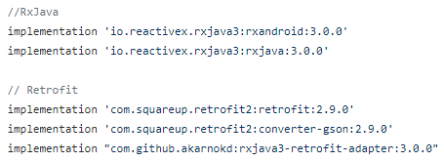
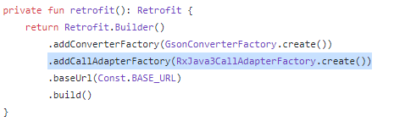
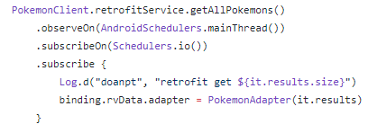
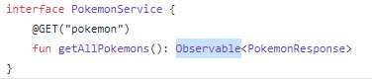
Retrofit with RxJava
1. Add library
3. Add RxJava as Call Adapter
4. Using Retrofit like a Rx call
2. Return Observable in Interface

Slide 34
Retrofit API Declaration
Annotations on the interface methods and its parameters indicate how a request will be handled
@GET
@POST
@PUT
@PATCH
@DELETE
@FormUrlEncoded
@Multipart
@Headers
@Header
@HeaderMap
@Query
@QueryMap
@Body
@Path
@ Url

Slide 35
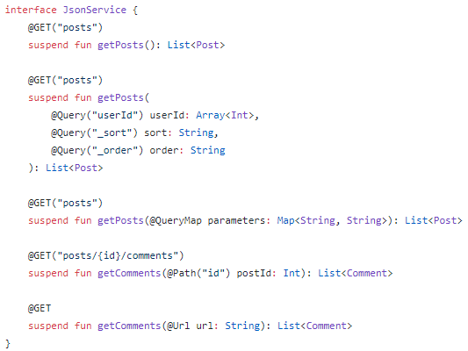
URL Manipulation
Sample GET annotation with @Path, @Query, @QueryMap and @Url
http://jsonplaceholder.typicode.com/posts
http://jsonplaceholder.typicode.com/posts?userId=5&_sort=id&_order=desc
Add parameter as map values passed same with Query annotation above
http://jsonplaceholder.typicode.com/posts/50/comments
Do get action as url parameter passed

Slide 36
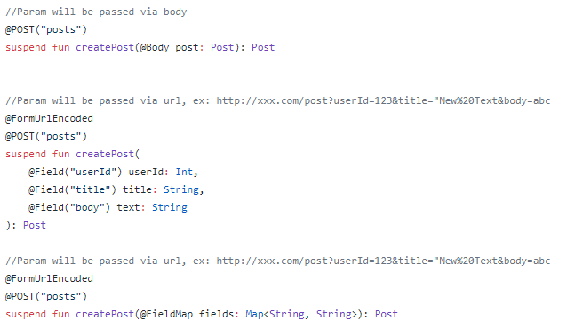
POST annotation
Post annotation used to create/add action

Slide 37
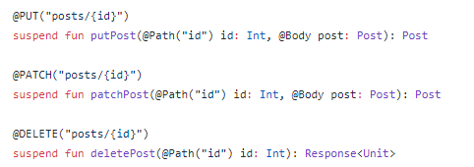
Update and Delete action
We can use PUT, PATCH, DELETE to perform update actions
PUT annotation will replace an existing object by another
PATCH annotation will update a field
DELETE annotation used to delete action

Slide 38
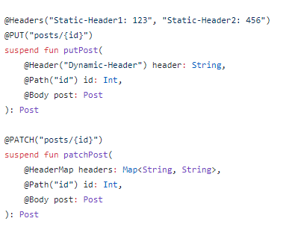
Add Header to request
We can add Headers to request by using Header annotation

Slide 39
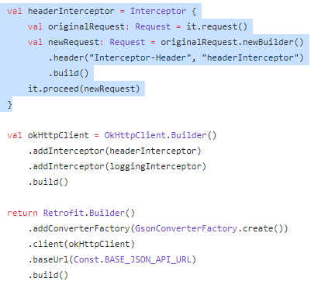
Add Header to request
If you want to add Header to every request, you can use Interceptor then add it to okHttp and Retrofit instance

Slide 40
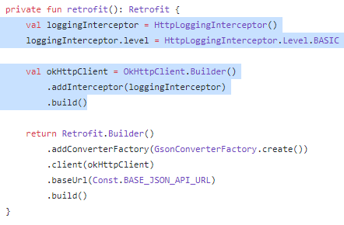
Logging with Retrofit
To print request log with retrofit, we use logging interceptor of ohHttp library
There are some levels of log: BASIC, BODY, HEADER, NONE

Slide 41
References
https://github.com/doanpt/android-learing/tree/pokedex
https://square.github.io/retrofit/
https://codinginflow.com/tutorials/android/retrofit/part-1-simple-get-request
https://codinginflow.com/tutorials/android/gson/part-1-simple-serialization-deserialization
https://developer.android.com/reference/java/net/HttpURLConnection
https://developer.android.com/training/basics/network-ops/xml
https://o7planning.org/10459/android-json-parser

Slide 42

Thank you

